Slide 1
PREFACTOR FORMULATION
Expressing the general matrix elements in terms of the multivalley basis using the prefactor formulation

Slide 2
GROUP THEORY
Resolving the input potential in terms of the irreducible representations of Td

Slide 3
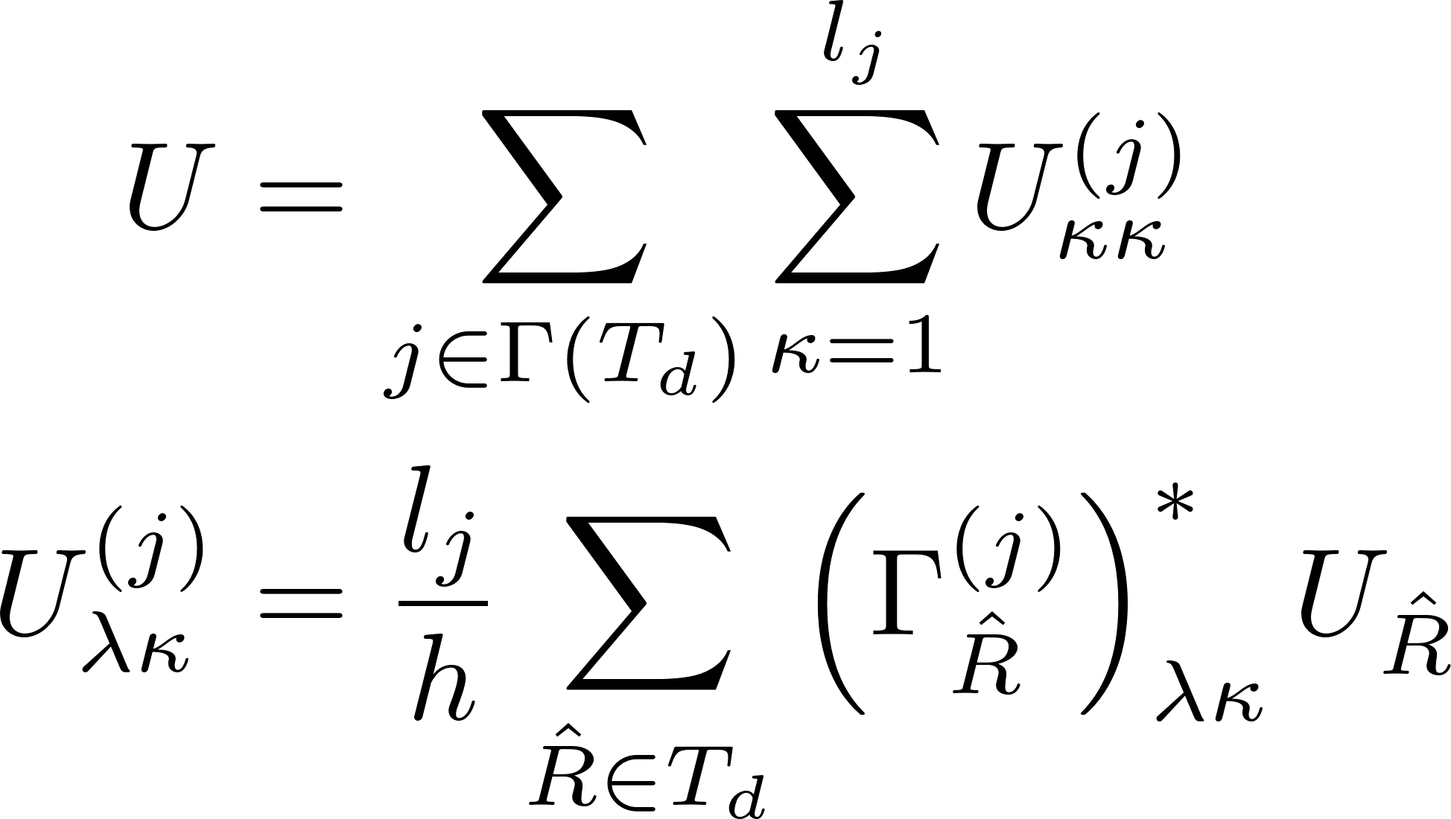
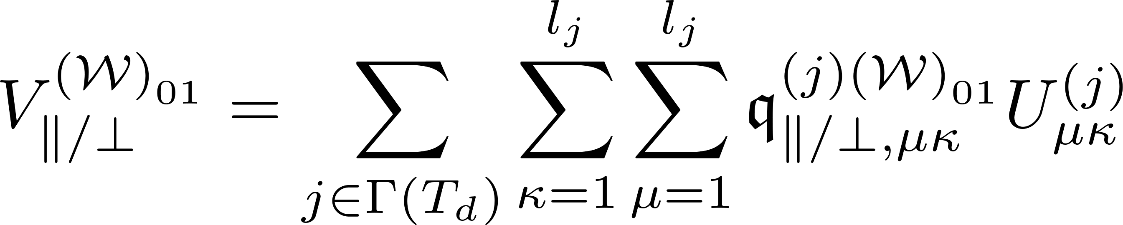
Symmetrized potential projected onto symmetries of Td -- I

Slide 4
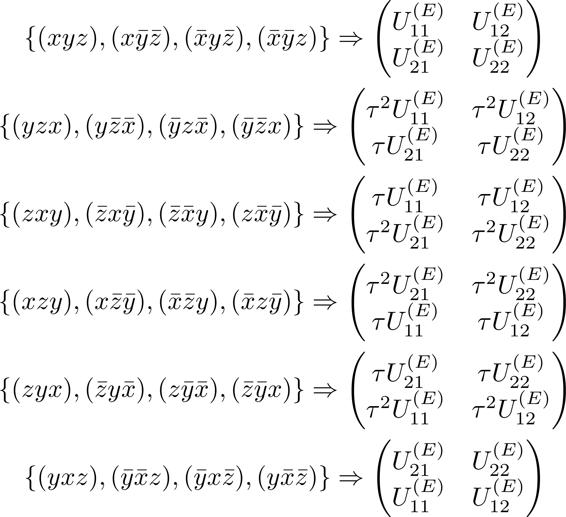
Matrix representation of T_{d} – A^{(σ)}, and E

Slide 5
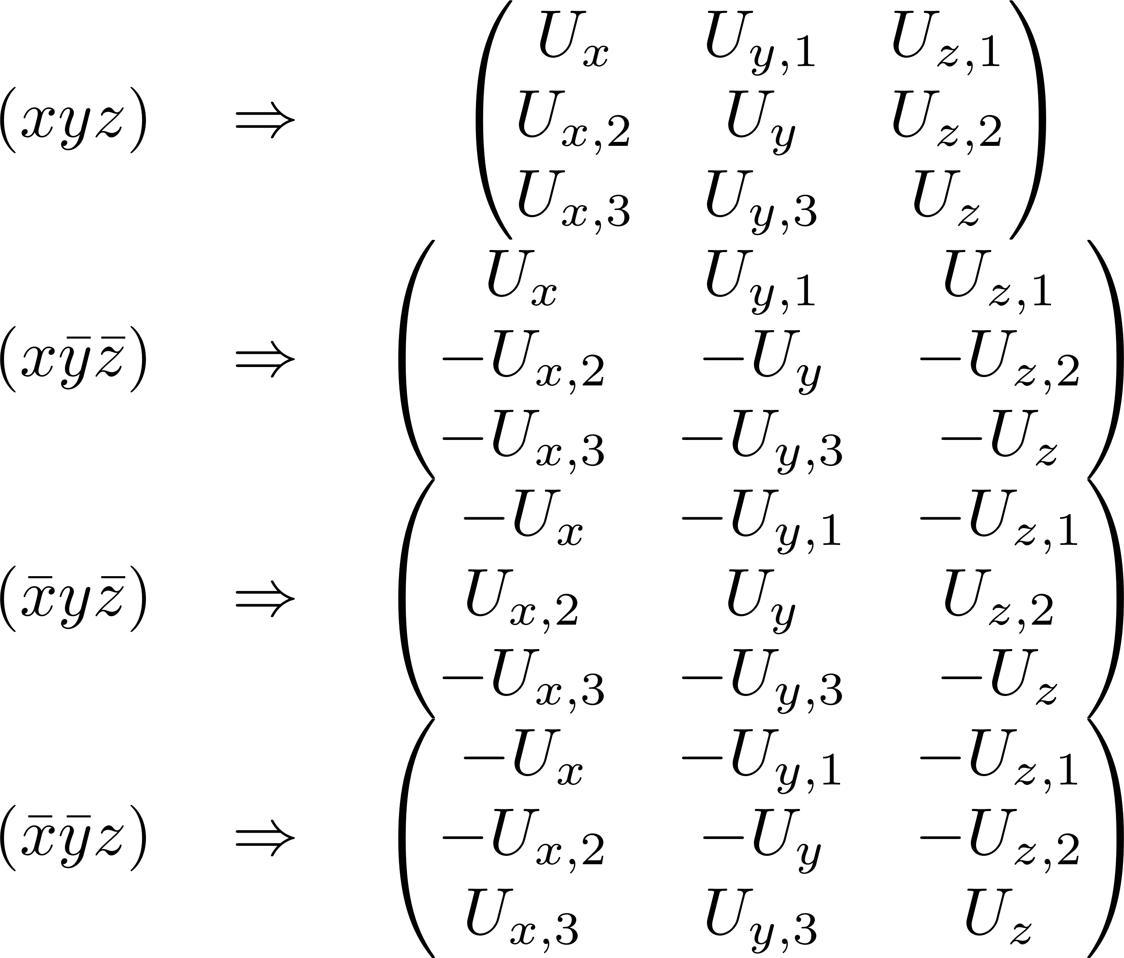
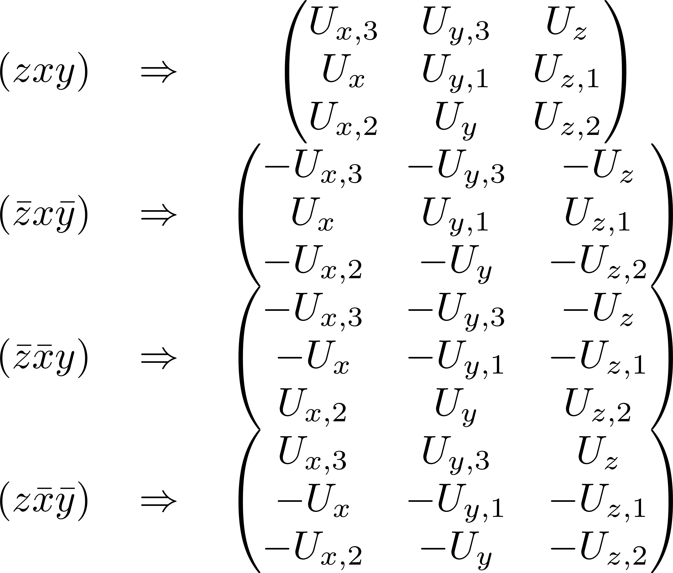
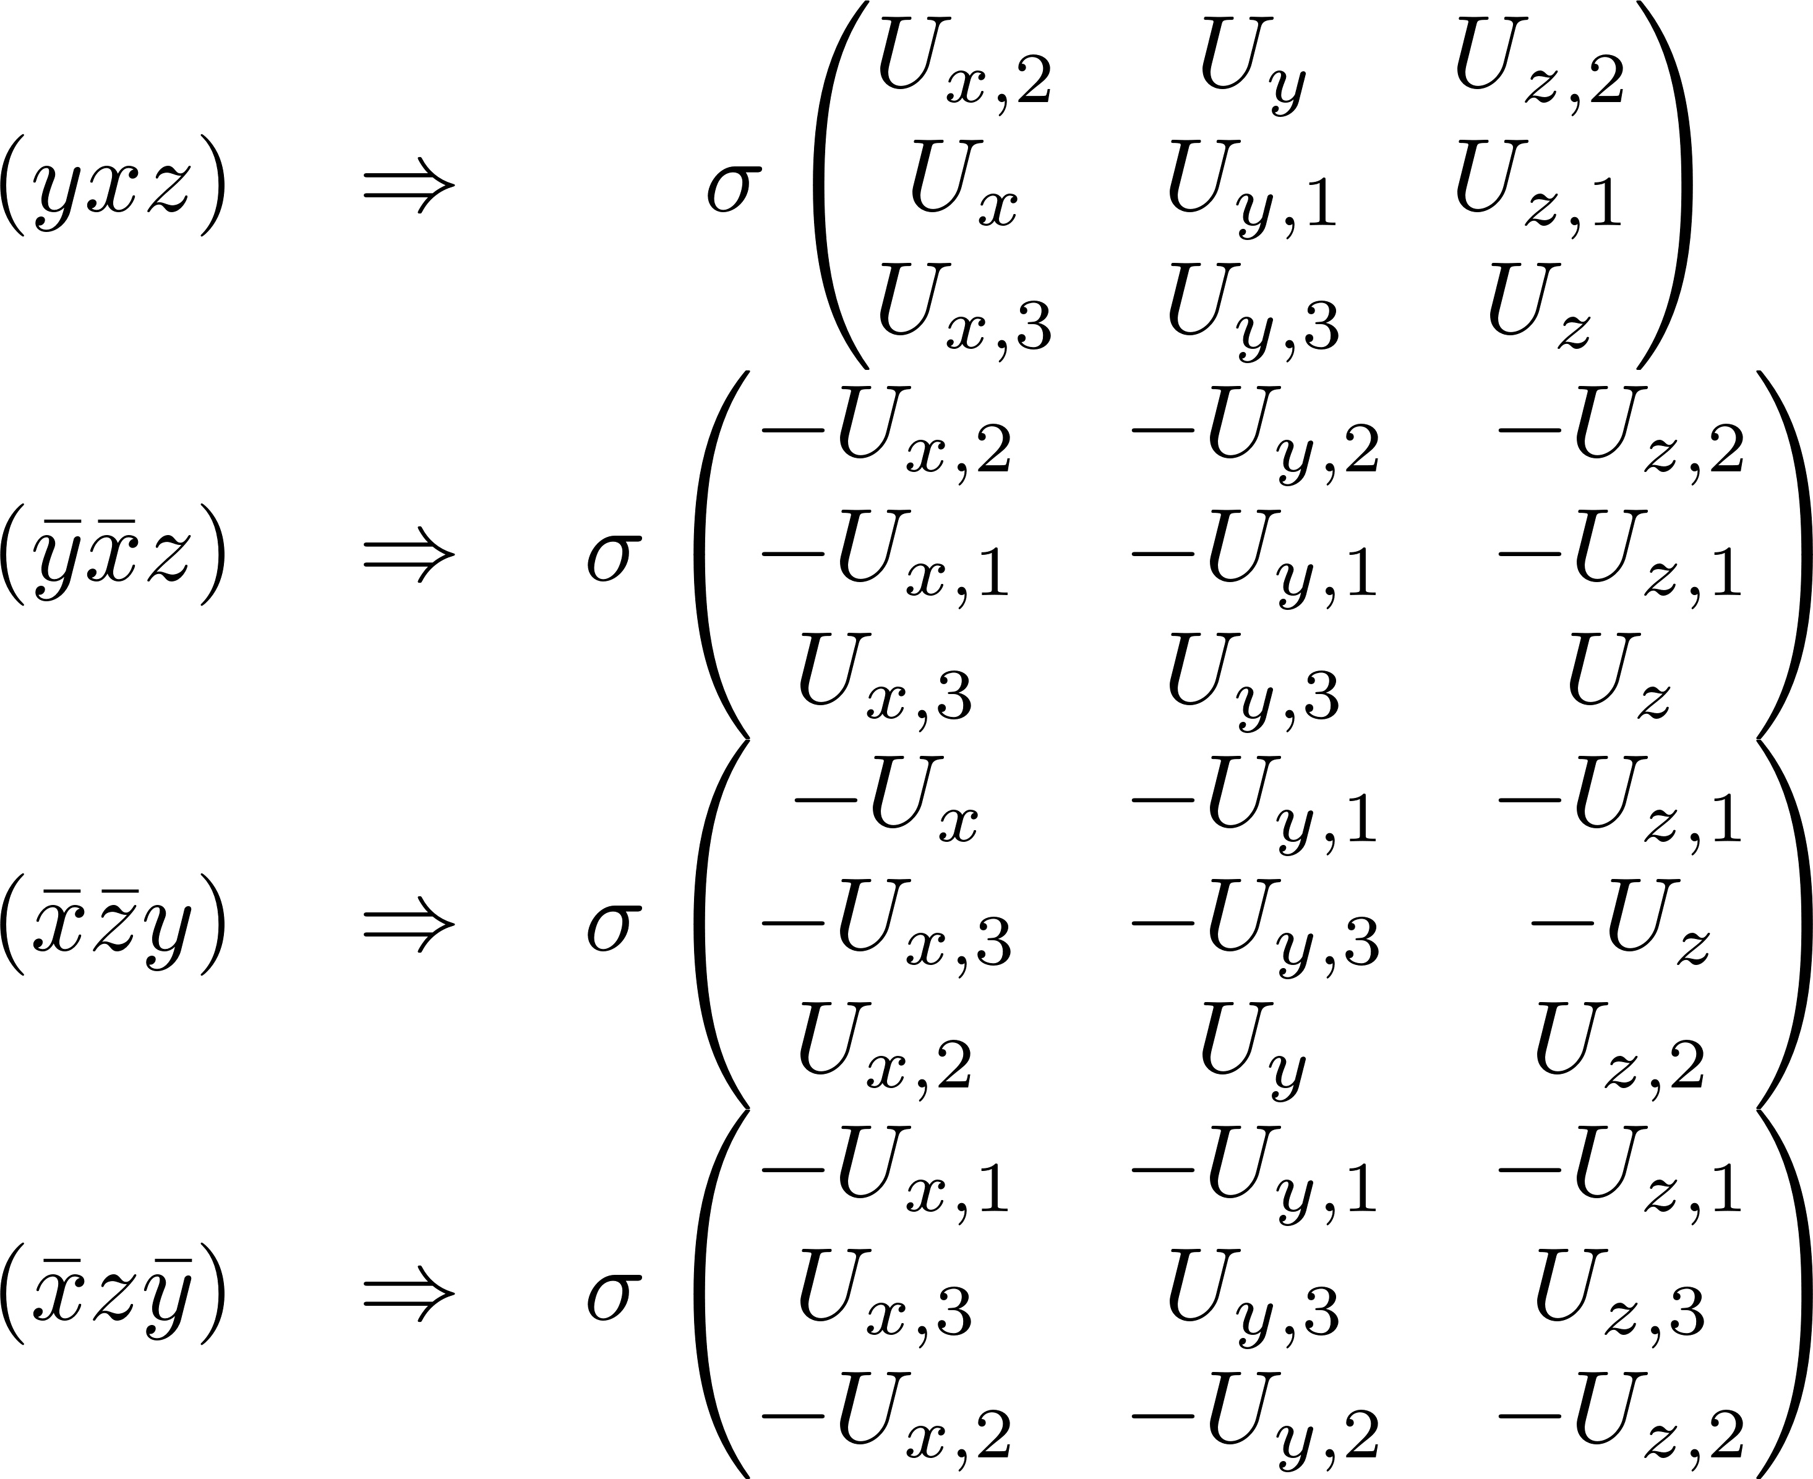
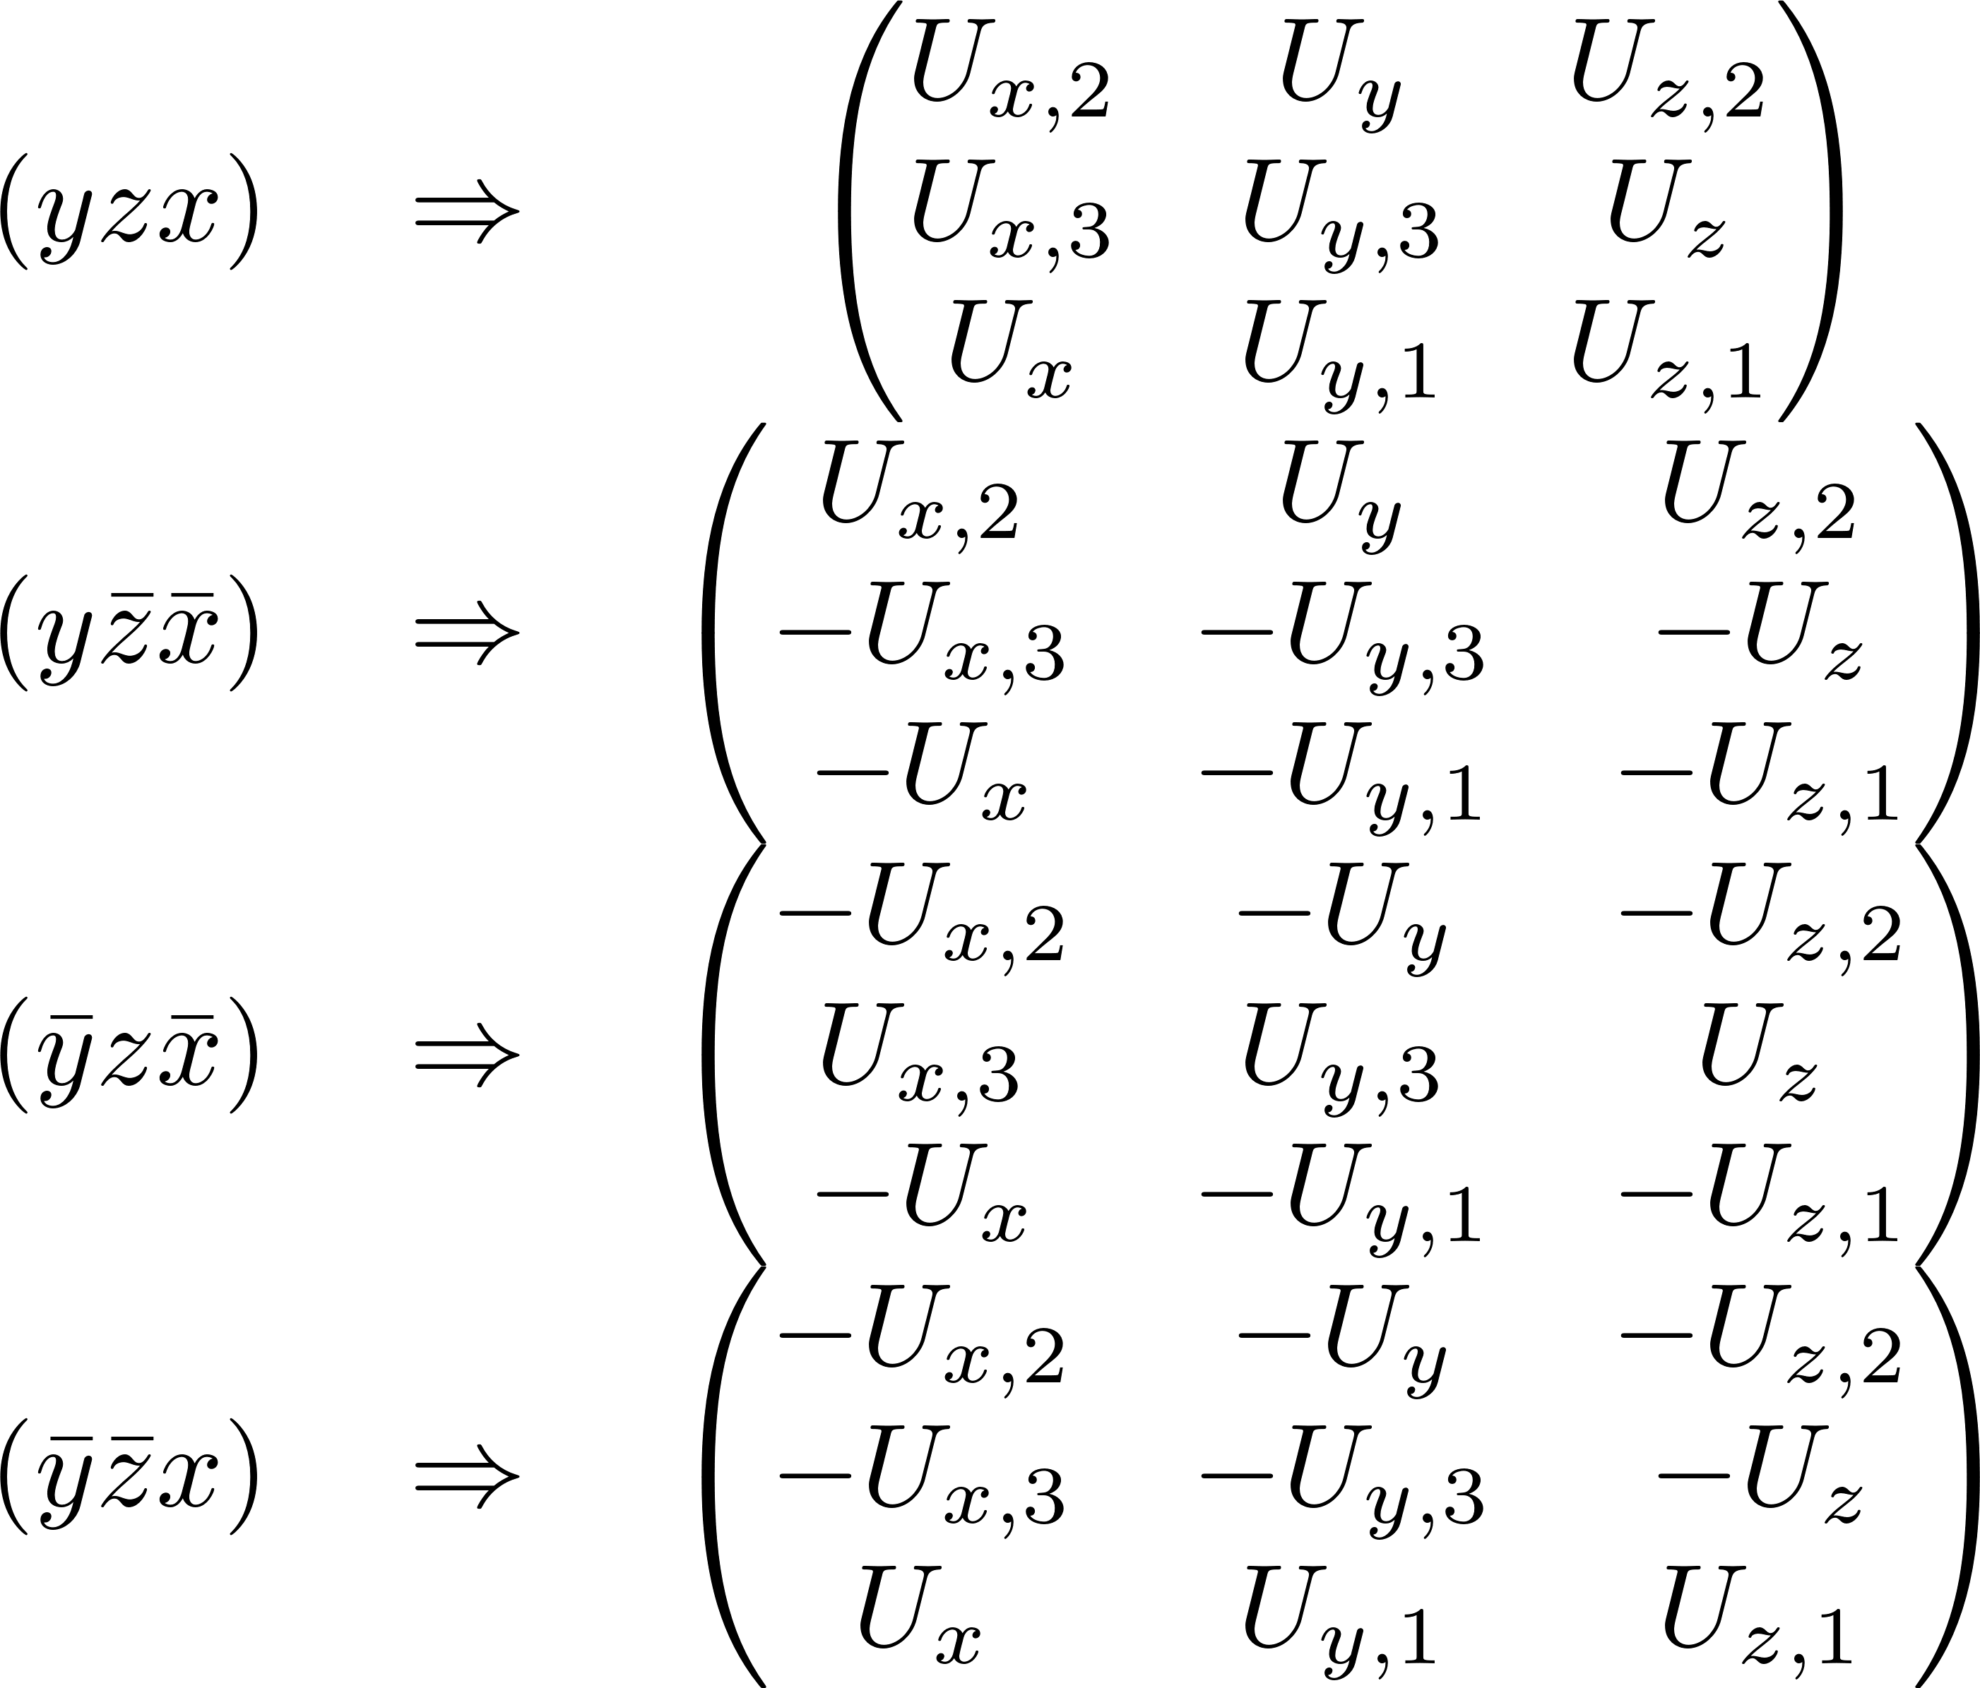
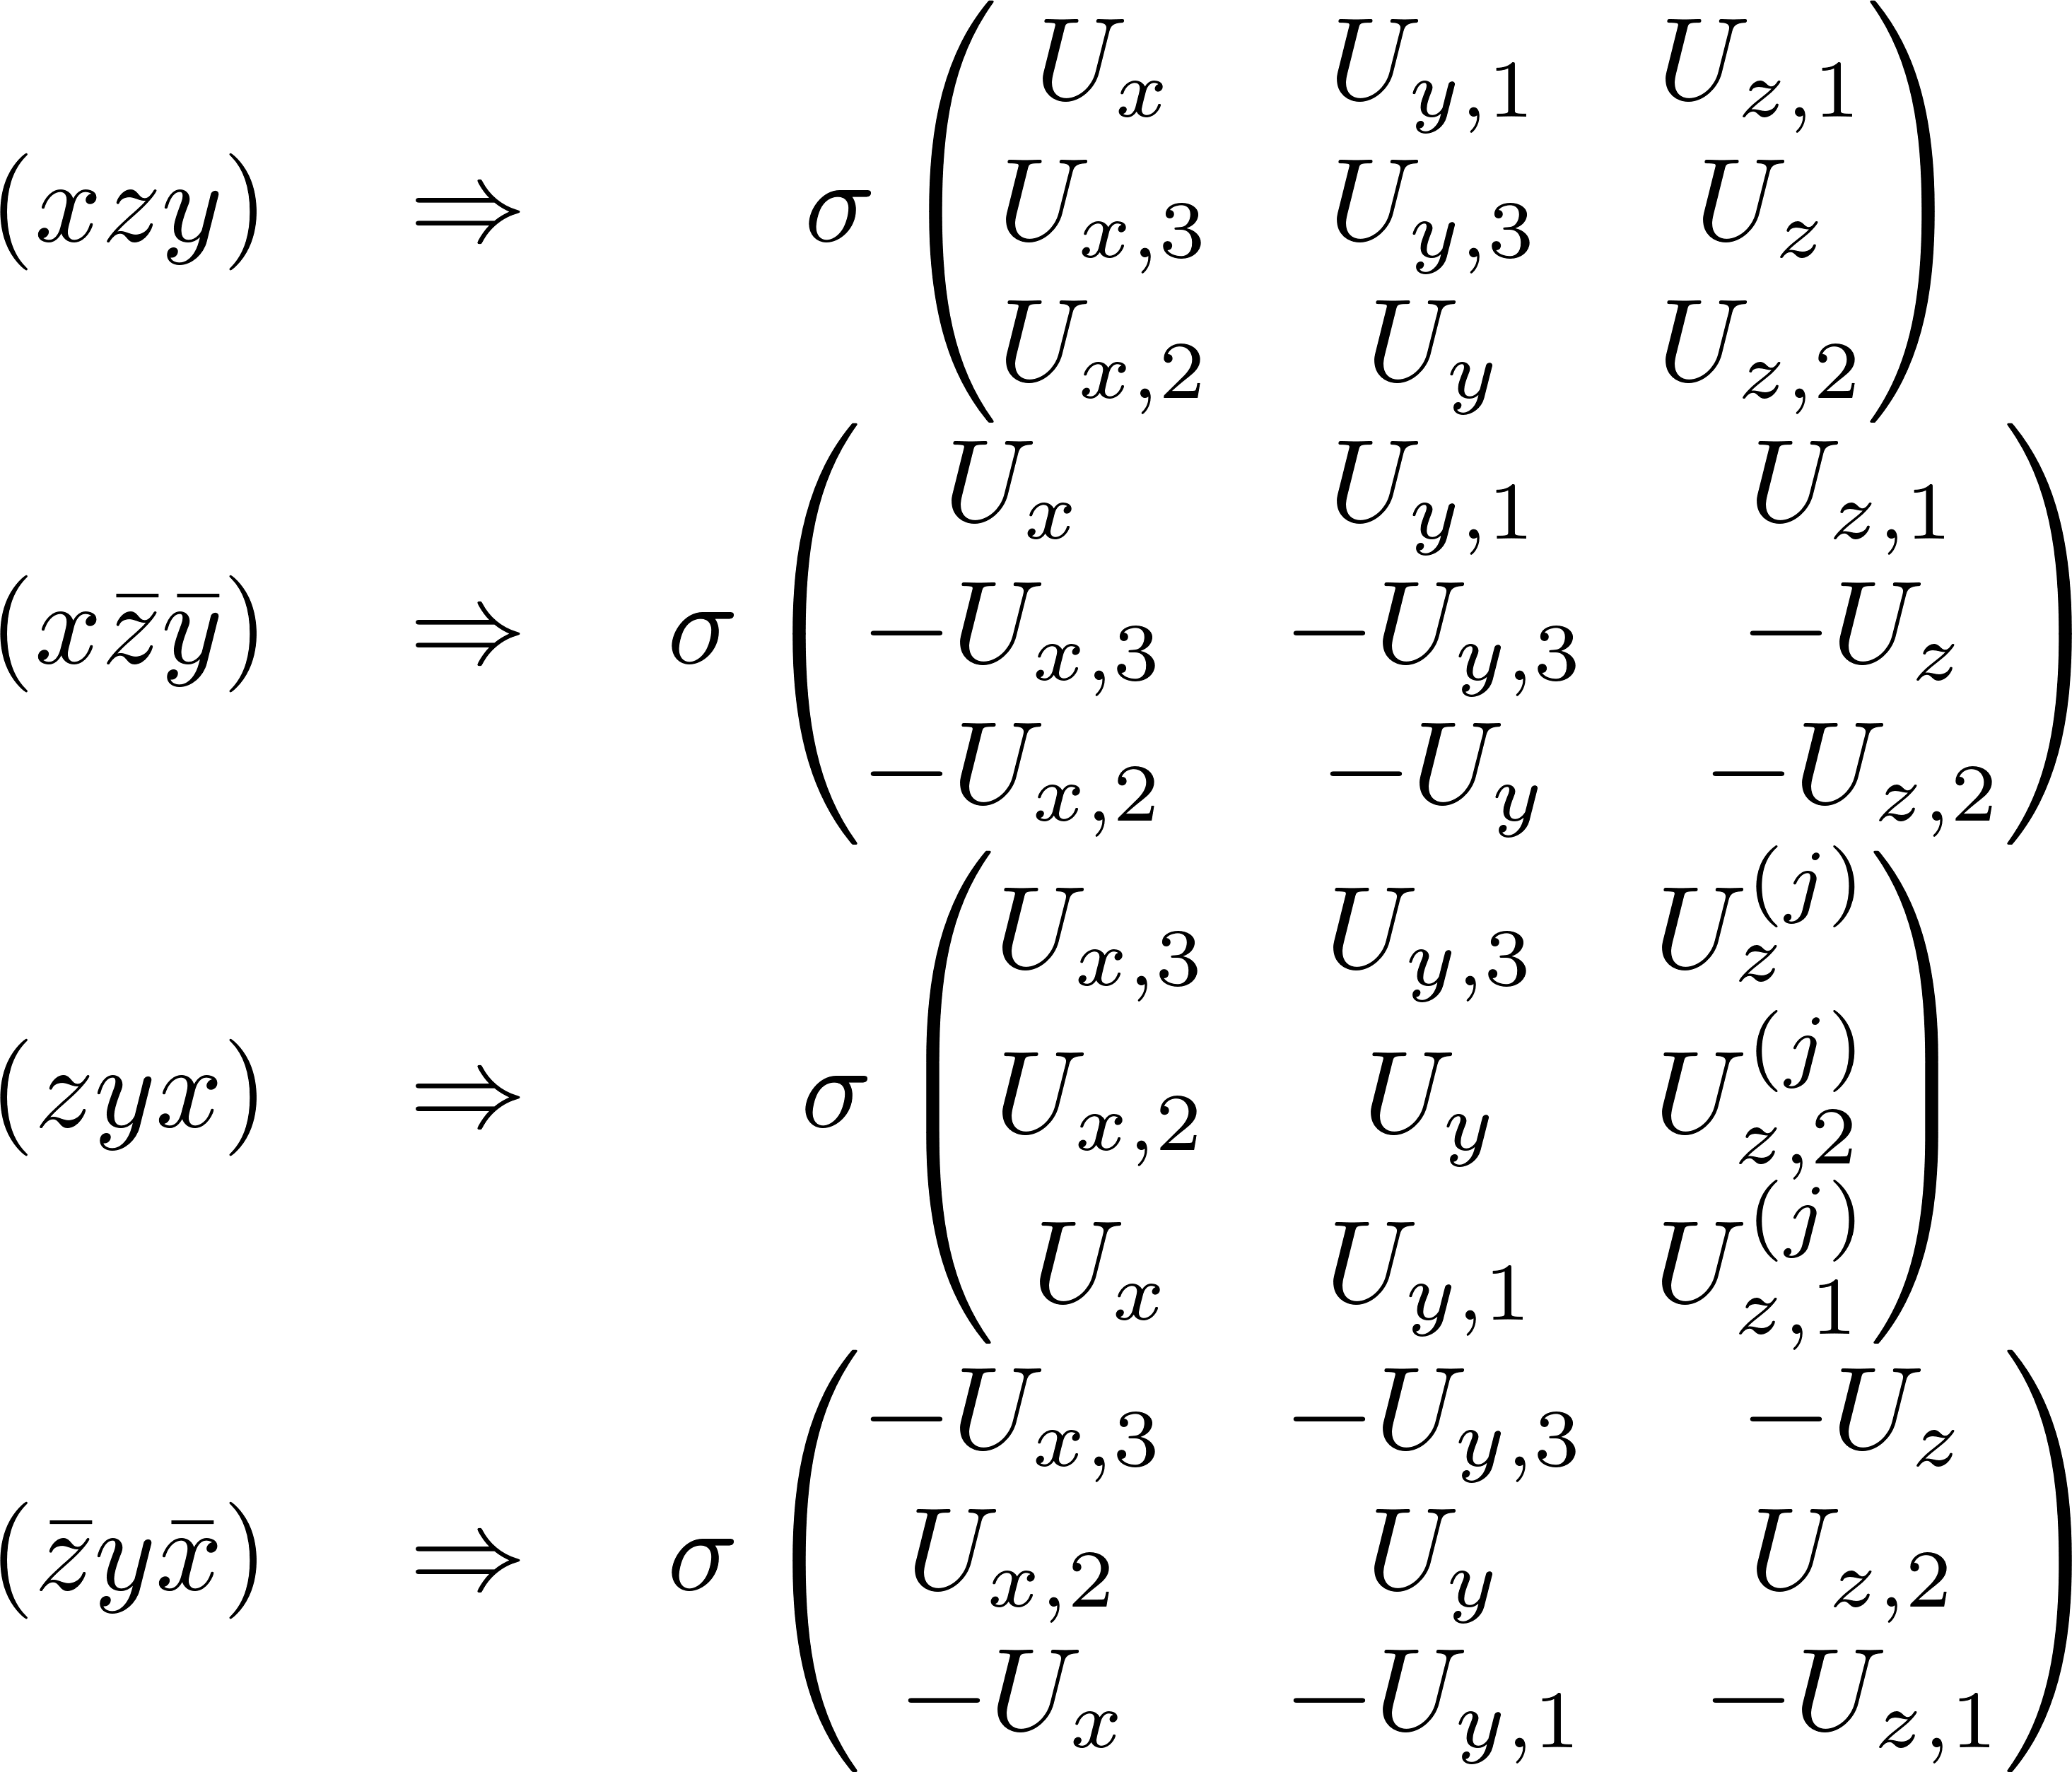
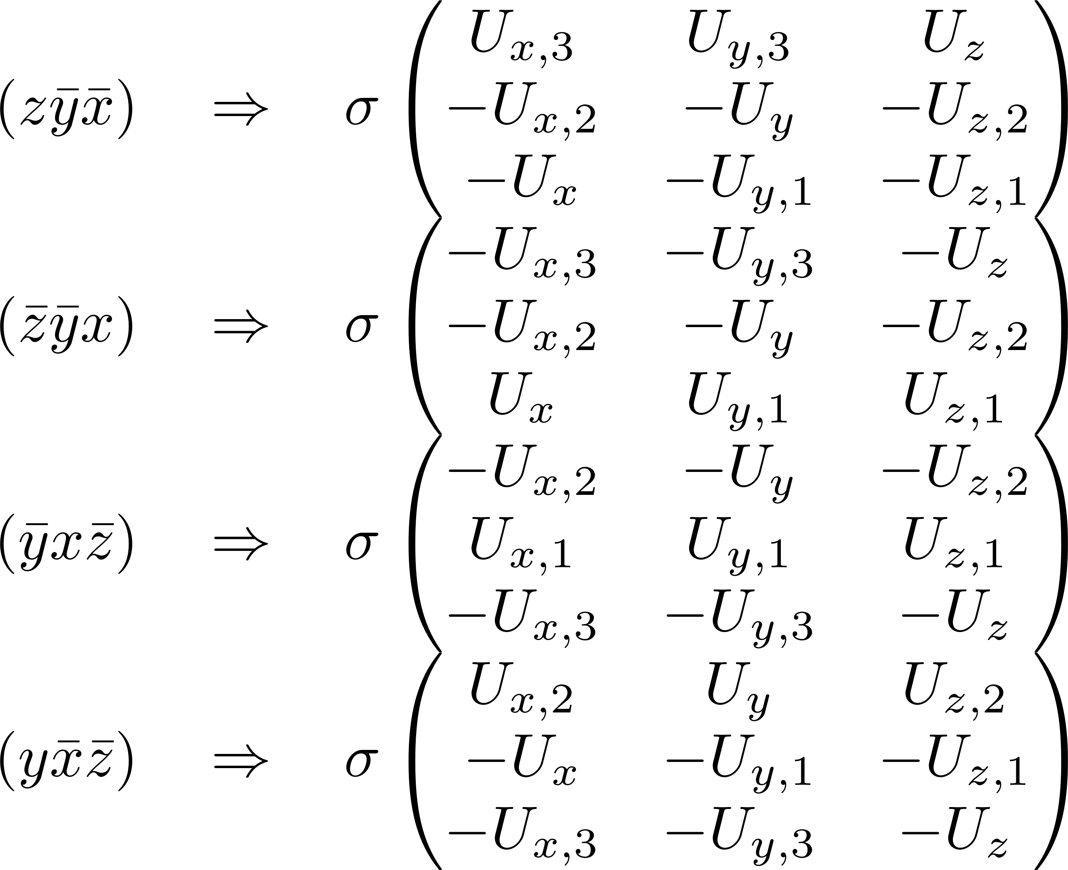
Matrix representation of T_{d} – T^{(σ)}

Slide 6
Potential Matrix
Expressing how potentials slot into integrals given state symmetry

Slide 7
A1

Slide 8
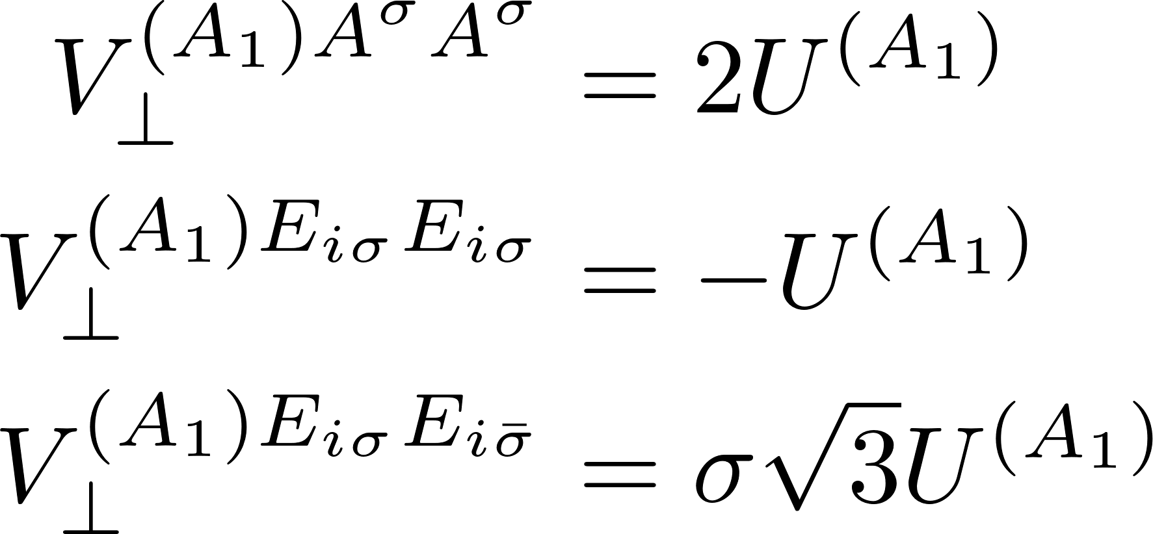
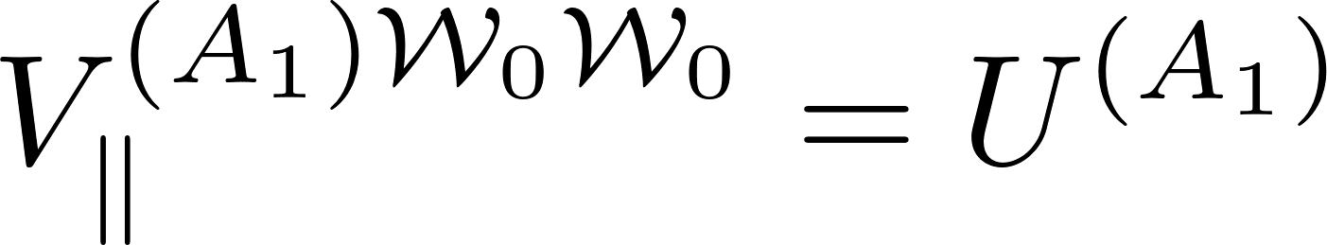
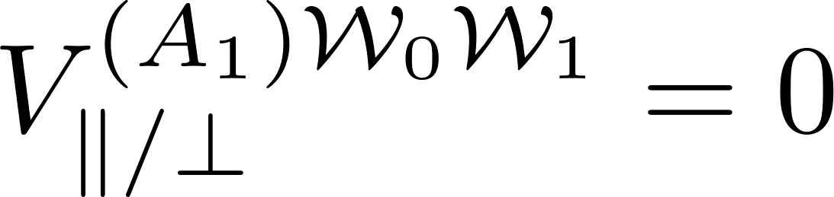
Effect of Td operations upon expanded symmetrized potential

Slide 9
A2

Slide 10
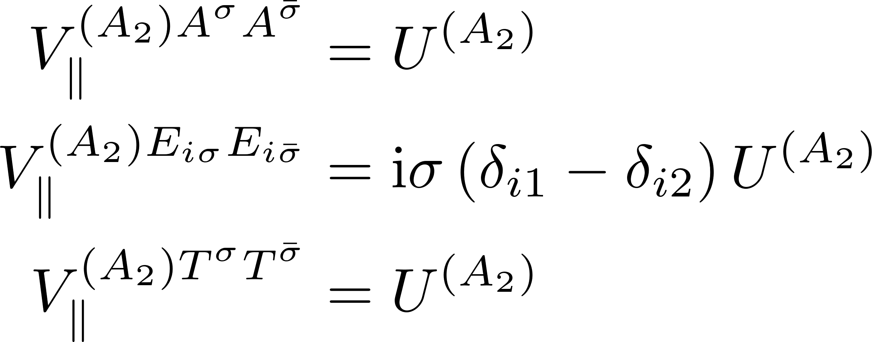
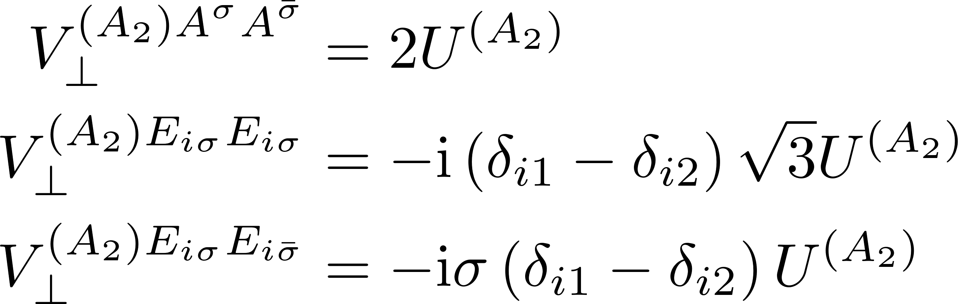
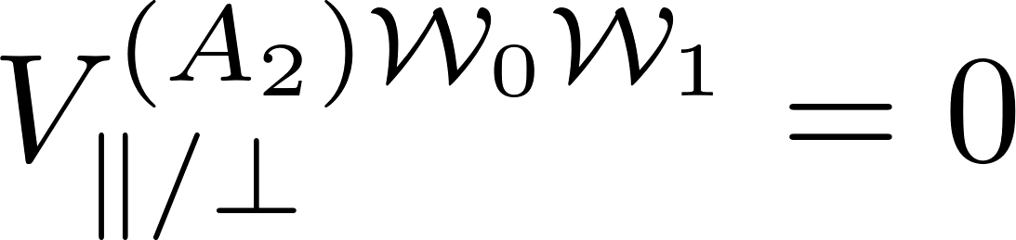
Effect of Td operations upon expanded symmetrized potential

Slide 11
E

Slide 12
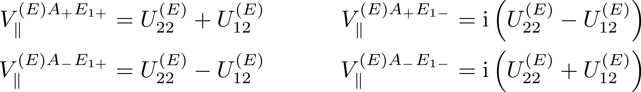
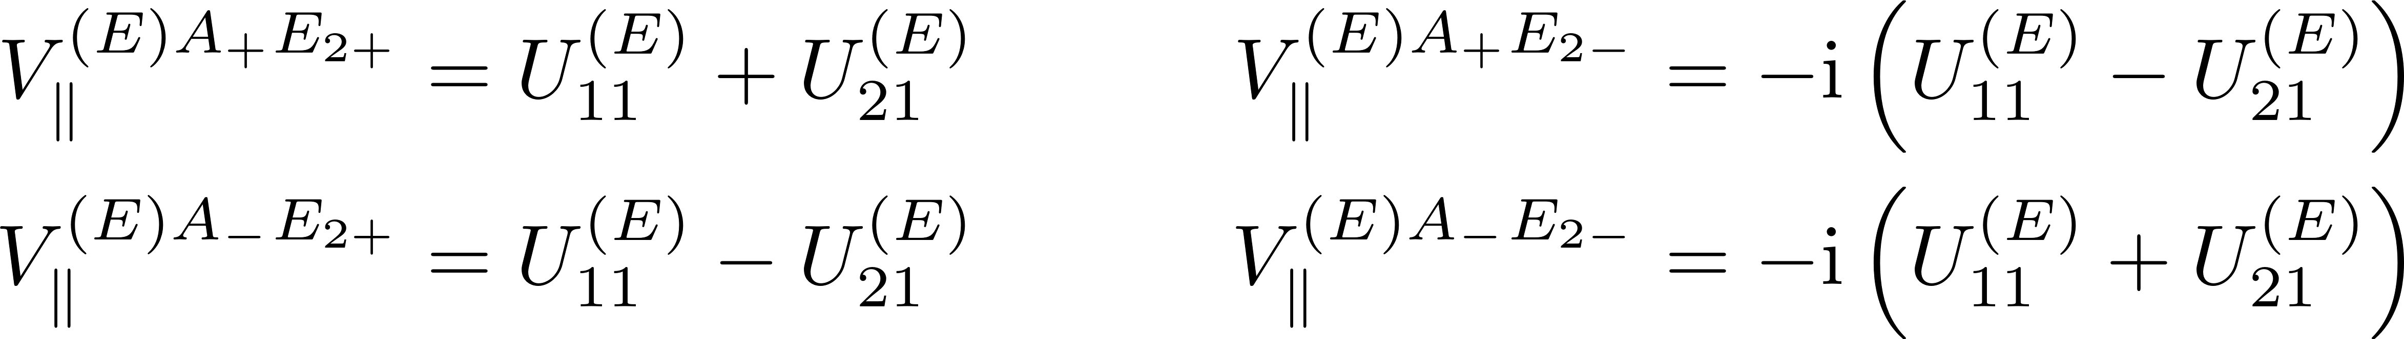
Effect of Td operations upon expanded symmetrized potential

Slide 13
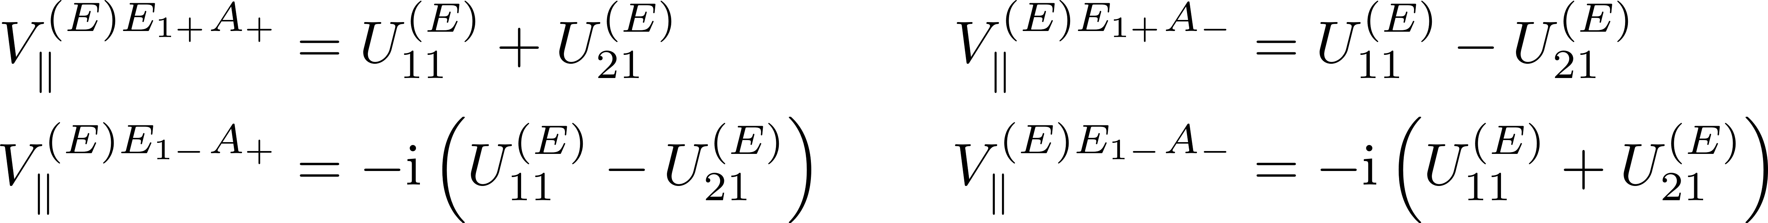
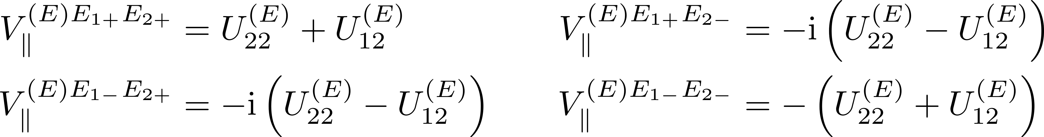
Effect of Td operations upon expanded symmetrized potential

Slide 14
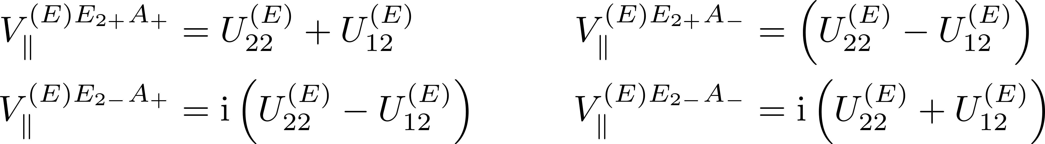
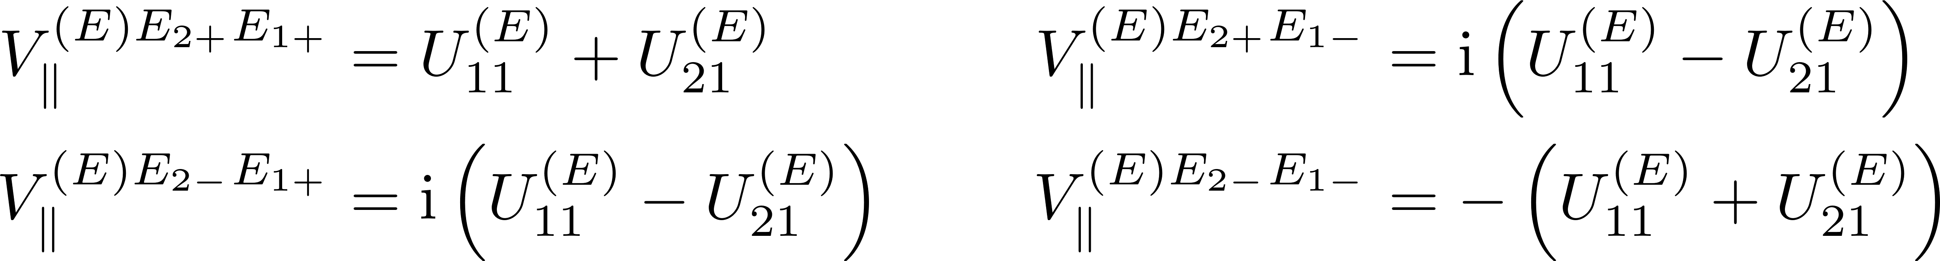
Effect of Td operations upon expanded symmetrized potential

Slide 15
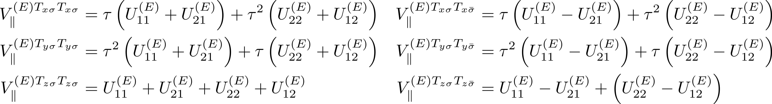
Effect of Td operations upon expanded symmetrized potential

Slide 16
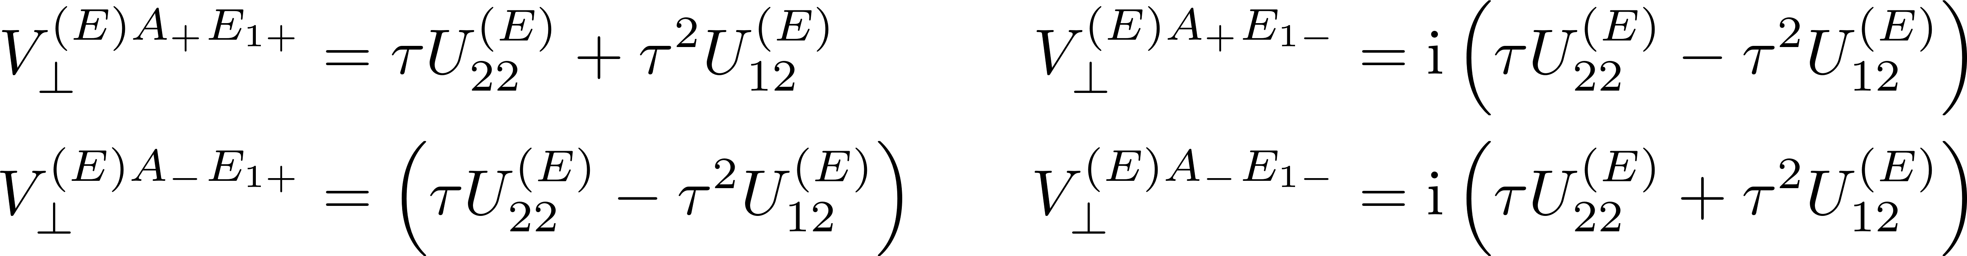
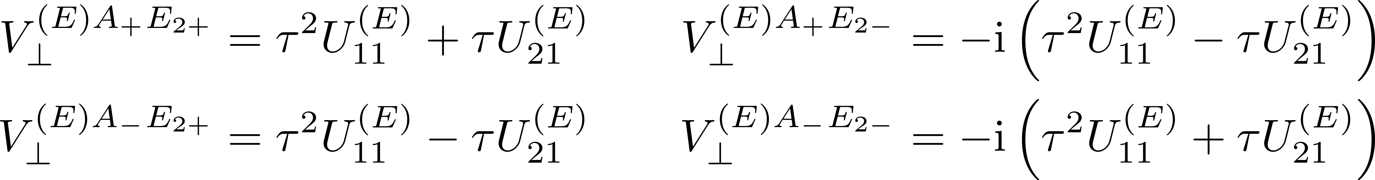
Effect of Td operations upon expanded symmetrized potential

Slide 17
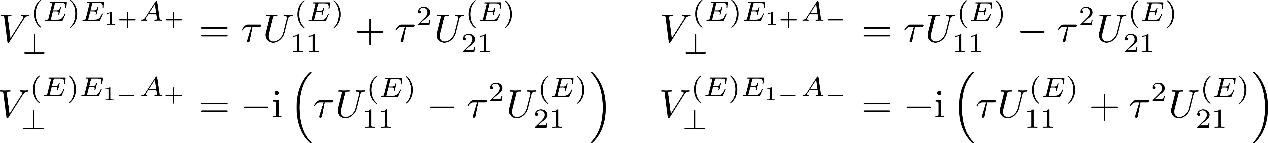
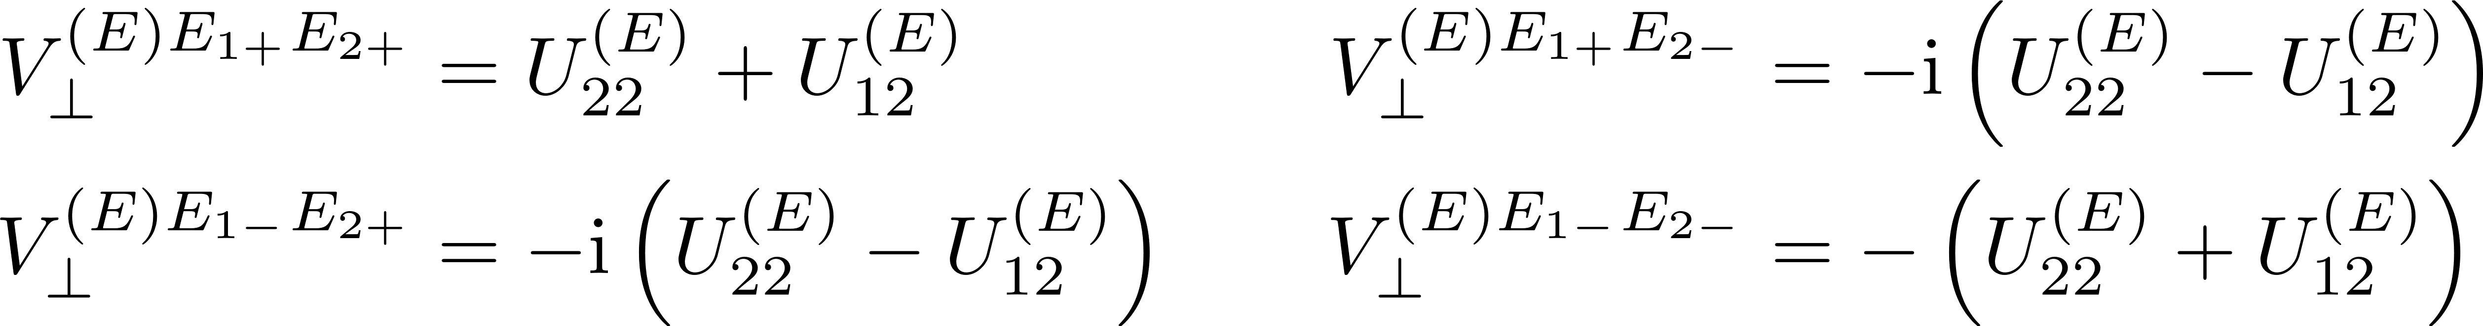
Effect of Td operations upon expanded symmetrized potential

Slide 18
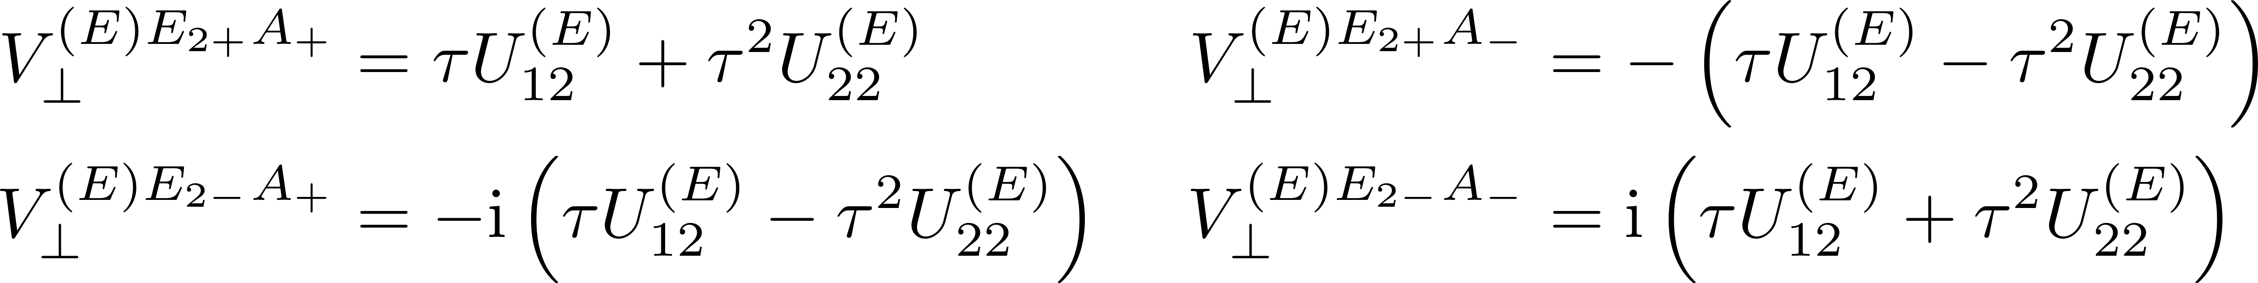
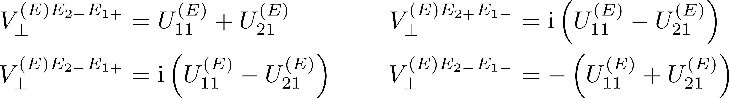
Effect of Td operations upon expanded symmetrized potential

Slide 19
T1

Slide 20
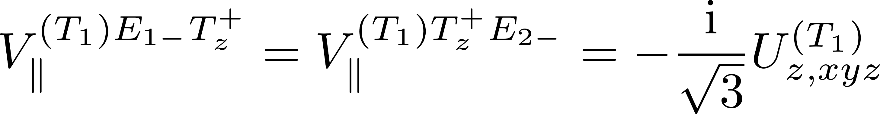
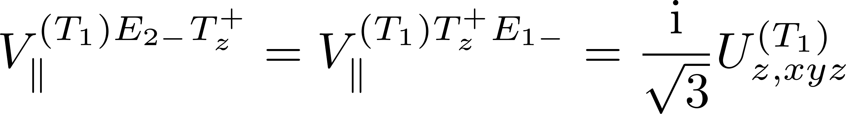
Effect of Td operations upon expanded symmetrized potential

Slide 21
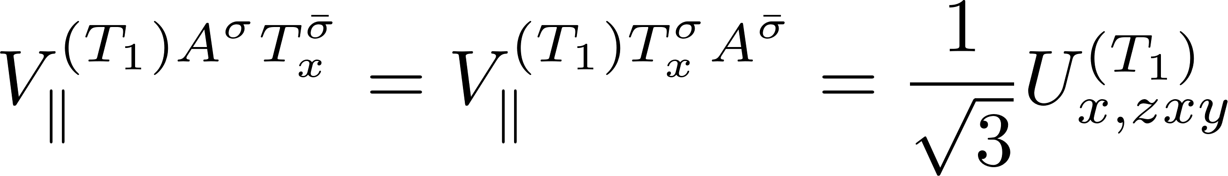
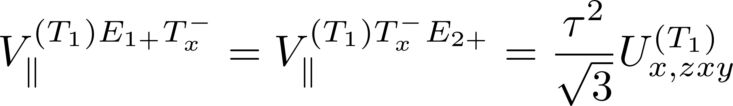
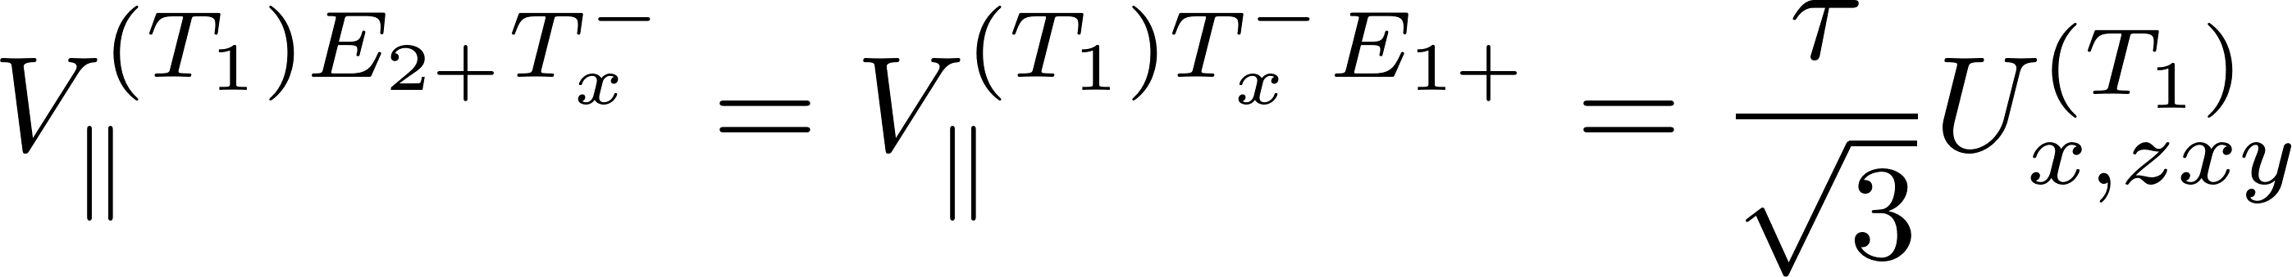
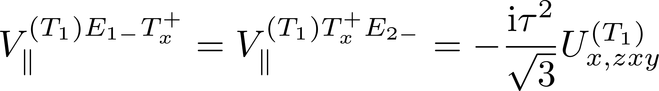

Effect of Td operations upon expanded symmetrized potential

Slide 22
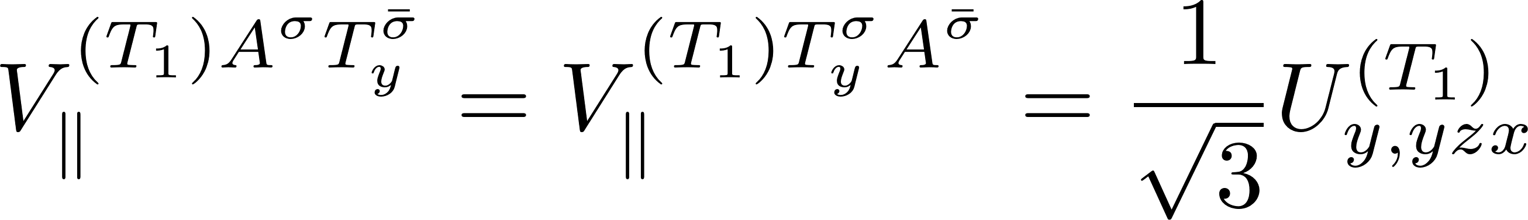
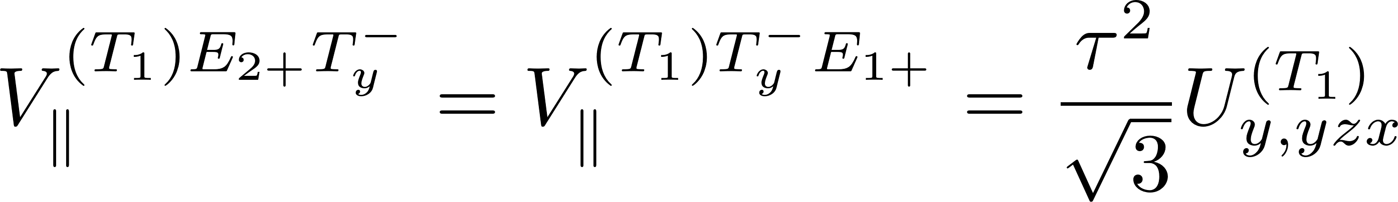
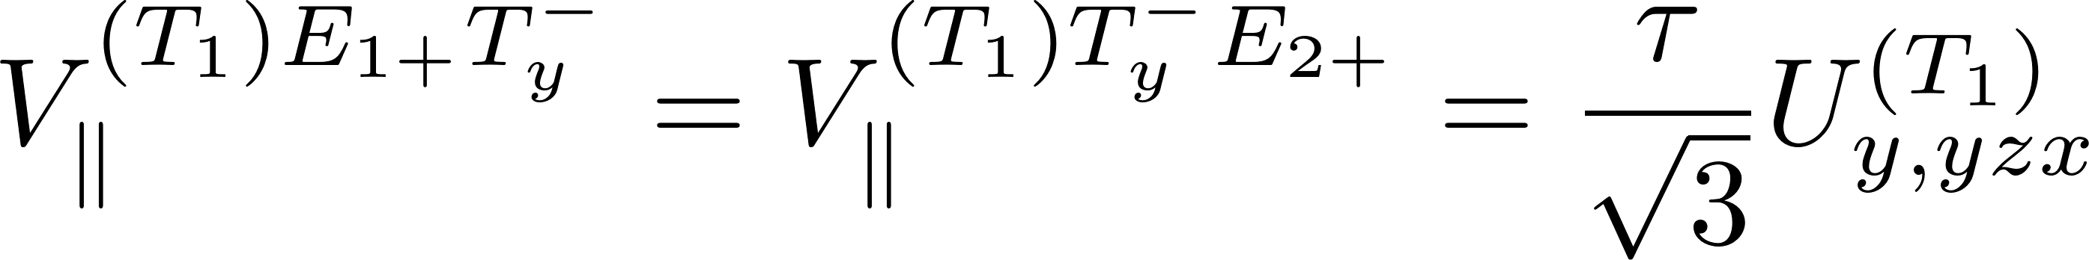
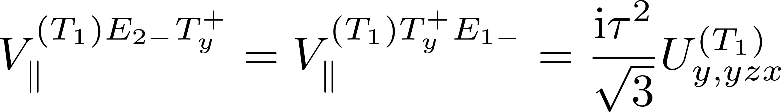
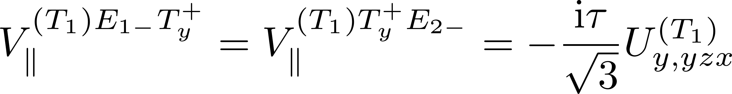
Effect of Td operations upon expanded symmetrized potential

Slide 23
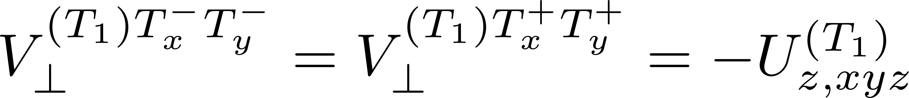
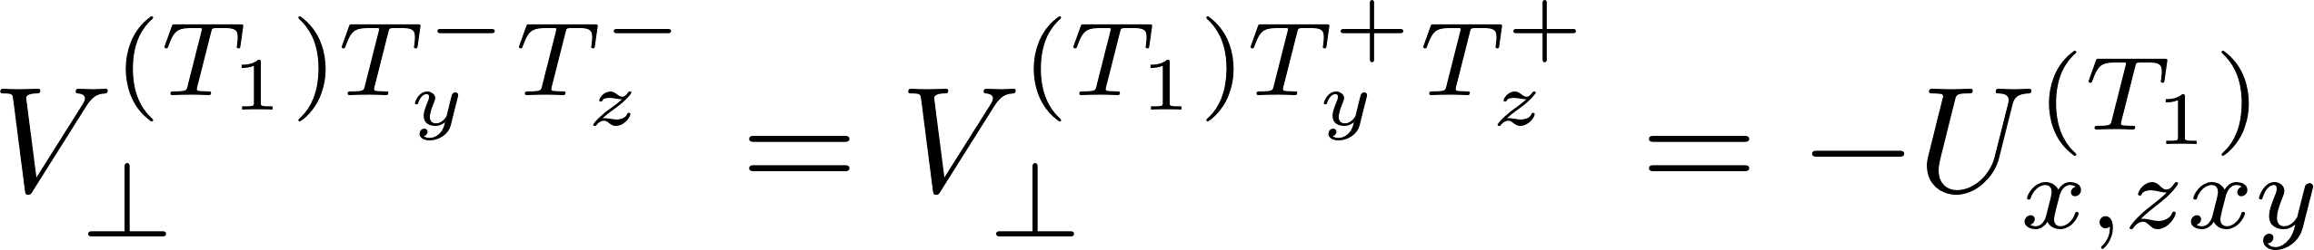
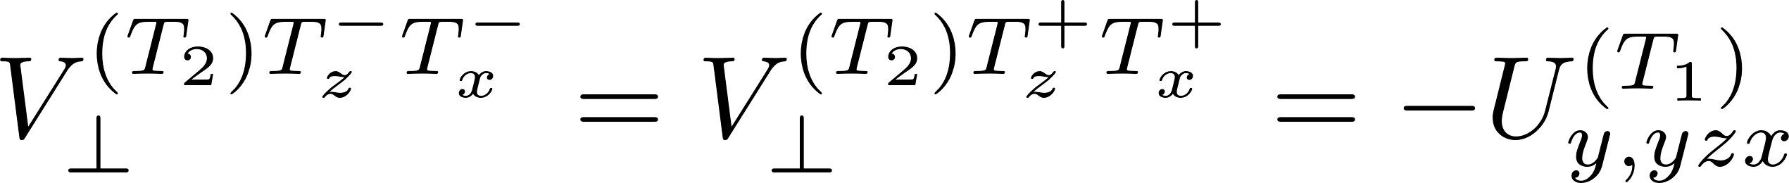
Effect of Td operations upon expanded symmetrized potential

Slide 24
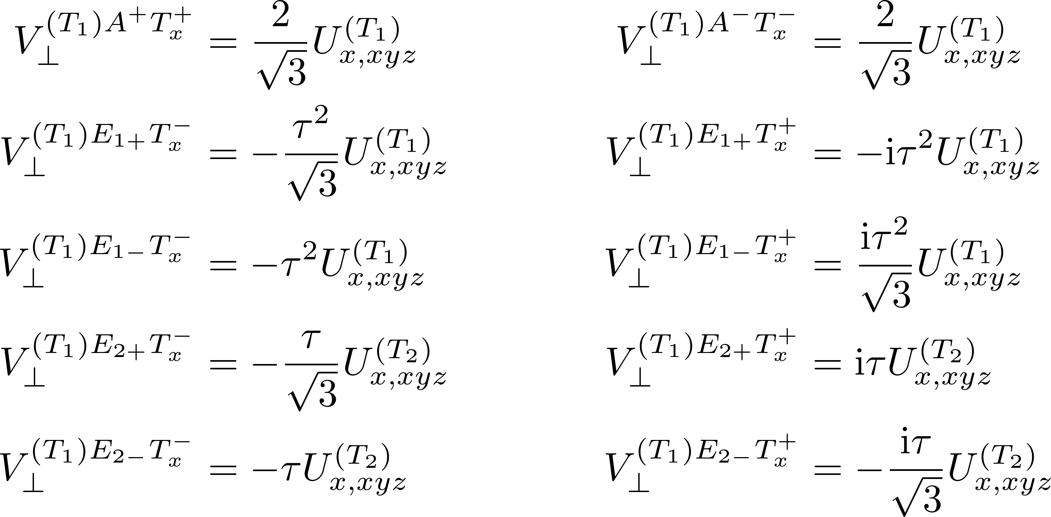
Effect of Td operations upon expanded symmetrized potential

Slide 25
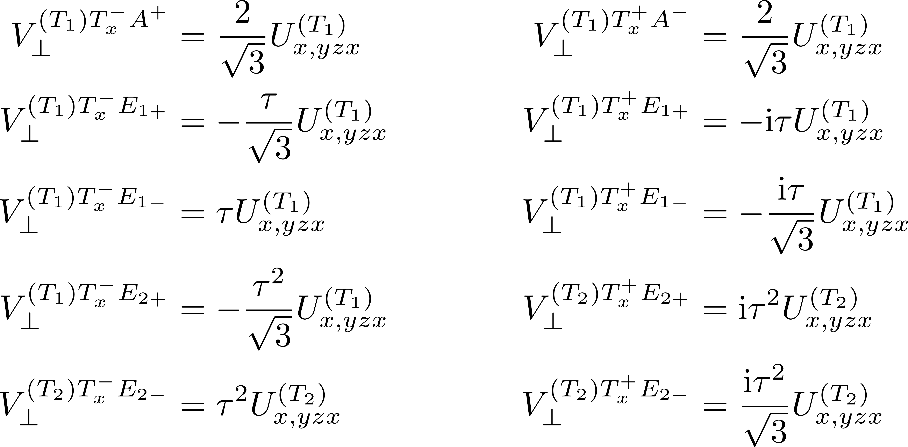
Effect of Td operations upon expanded symmetrized potential

Slide 26
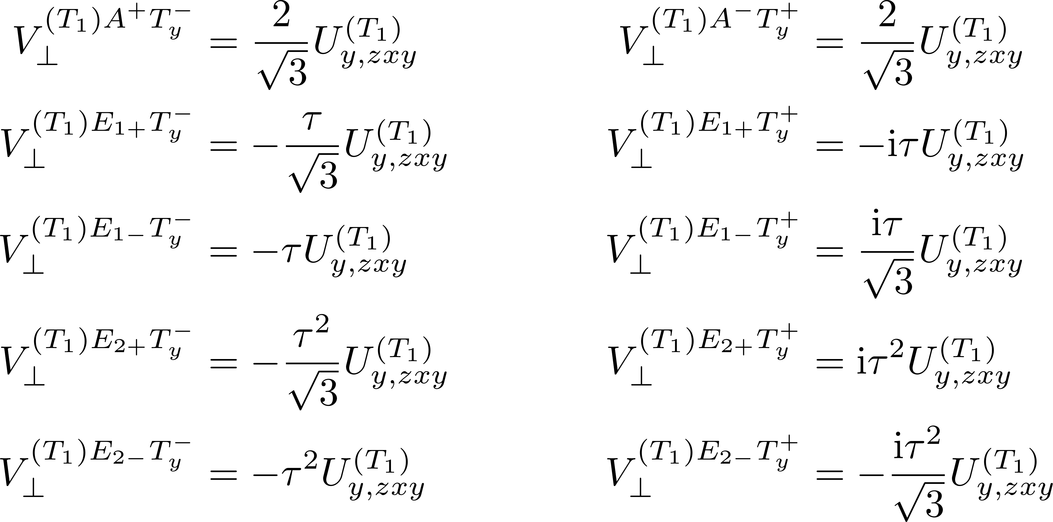
Effect of Td operations upon expanded symmetrized potential

Slide 27
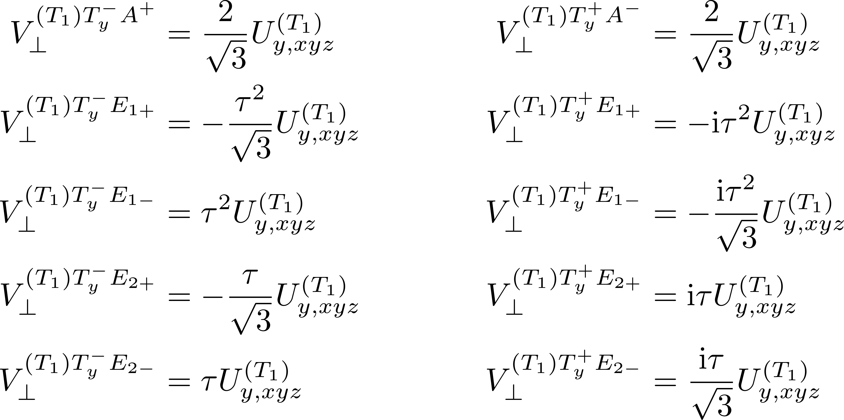
Effect of Td operations upon expanded symmetrized potential

Slide 28
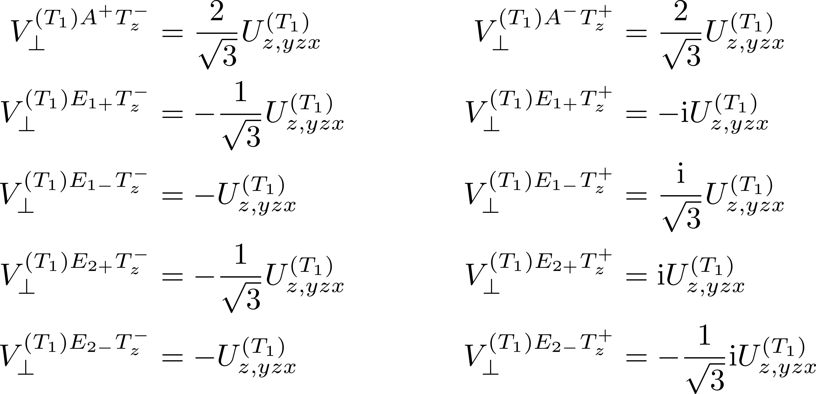
Effect of Td operations upon expanded symmetrized potential

Slide 29
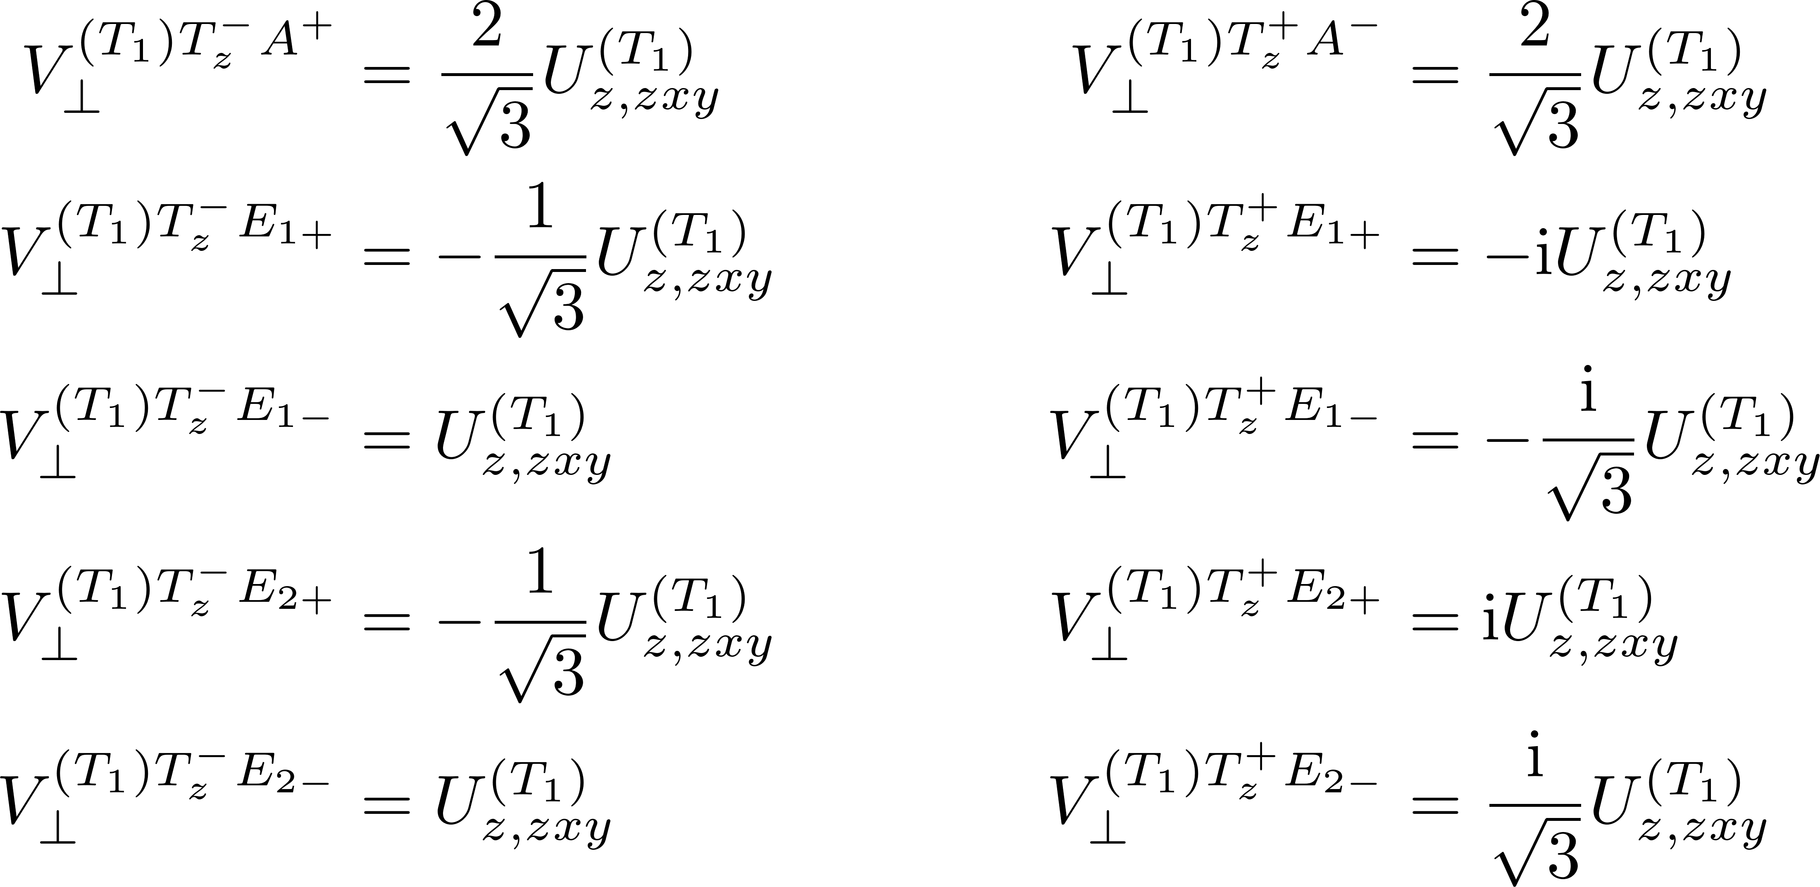
Effect of Td operations upon expanded symmetrized potential

Slide 30
T2

Slide 31
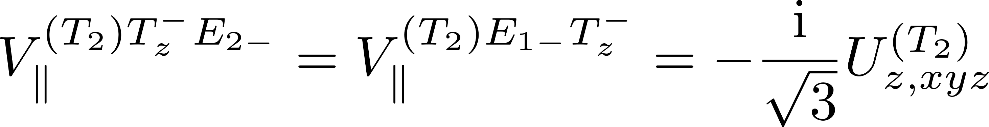
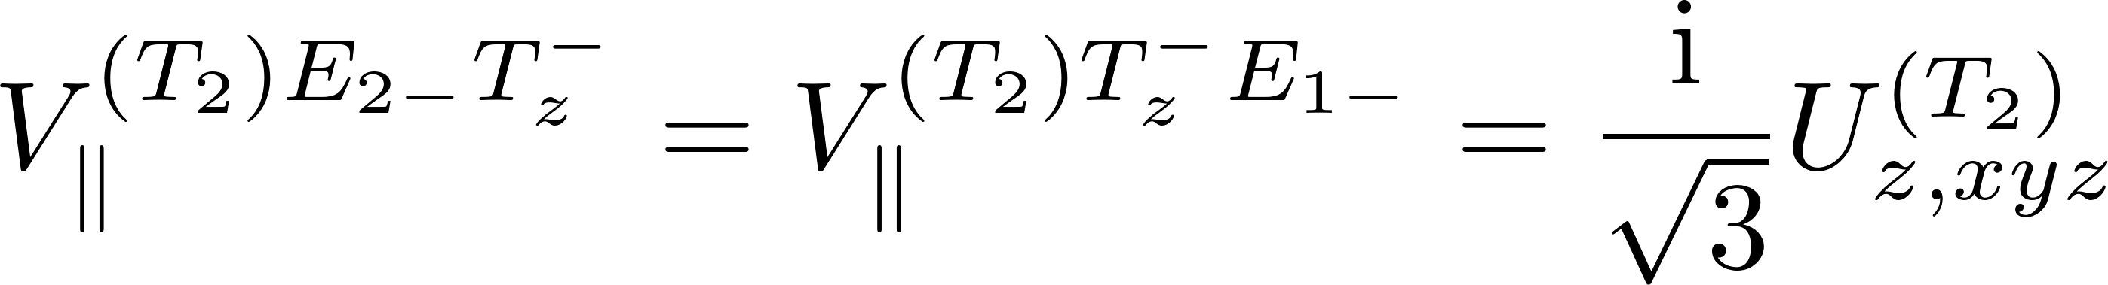
Effect of Td operations upon expanded symmetrized potential

Slide 32





Effect of Td operations upon expanded symmetrized potential

Slide 33





Effect of Td operations upon expanded symmetrized potential

Slide 34



Effect of Td operations upon expanded symmetrized potential

Slide 35

Effect of Td operations upon expanded symmetrized potential

Slide 36

Effect of Td operations upon expanded symmetrized potential

Slide 37

Effect of Td operations upon expanded symmetrized potential

Slide 38

Effect of Td operations upon expanded symmetrized potential

Slide 39

Effect of Td operations upon expanded symmetrized potential

Slide 40

Effect of Td operations upon expanded symmetrized potential

